Slide 1
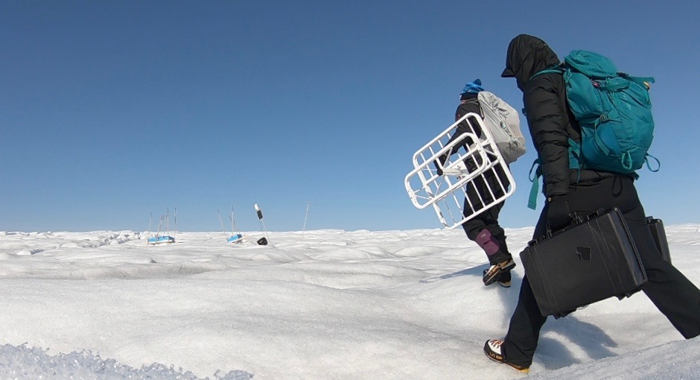
Greenland 2019
Processed by: NICOLe Bienert
Executed By: EliZA Dawson, Mickey Mackie, Sean Peters
Photo Credits: Eliza

Slide 2
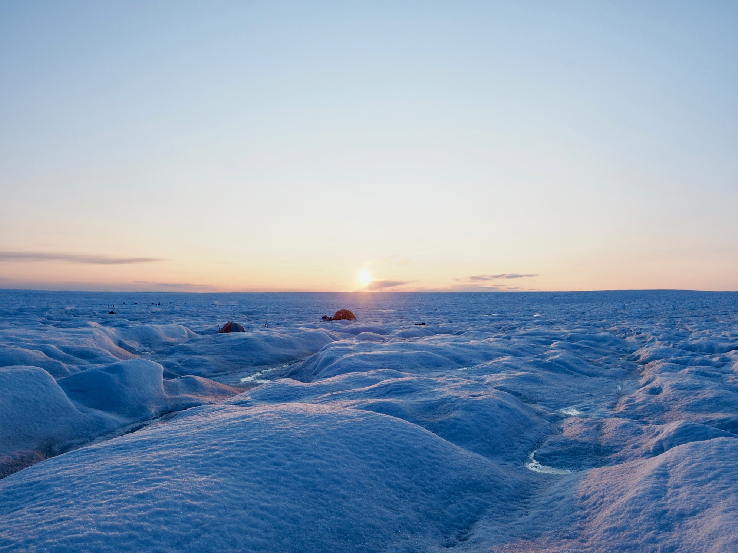
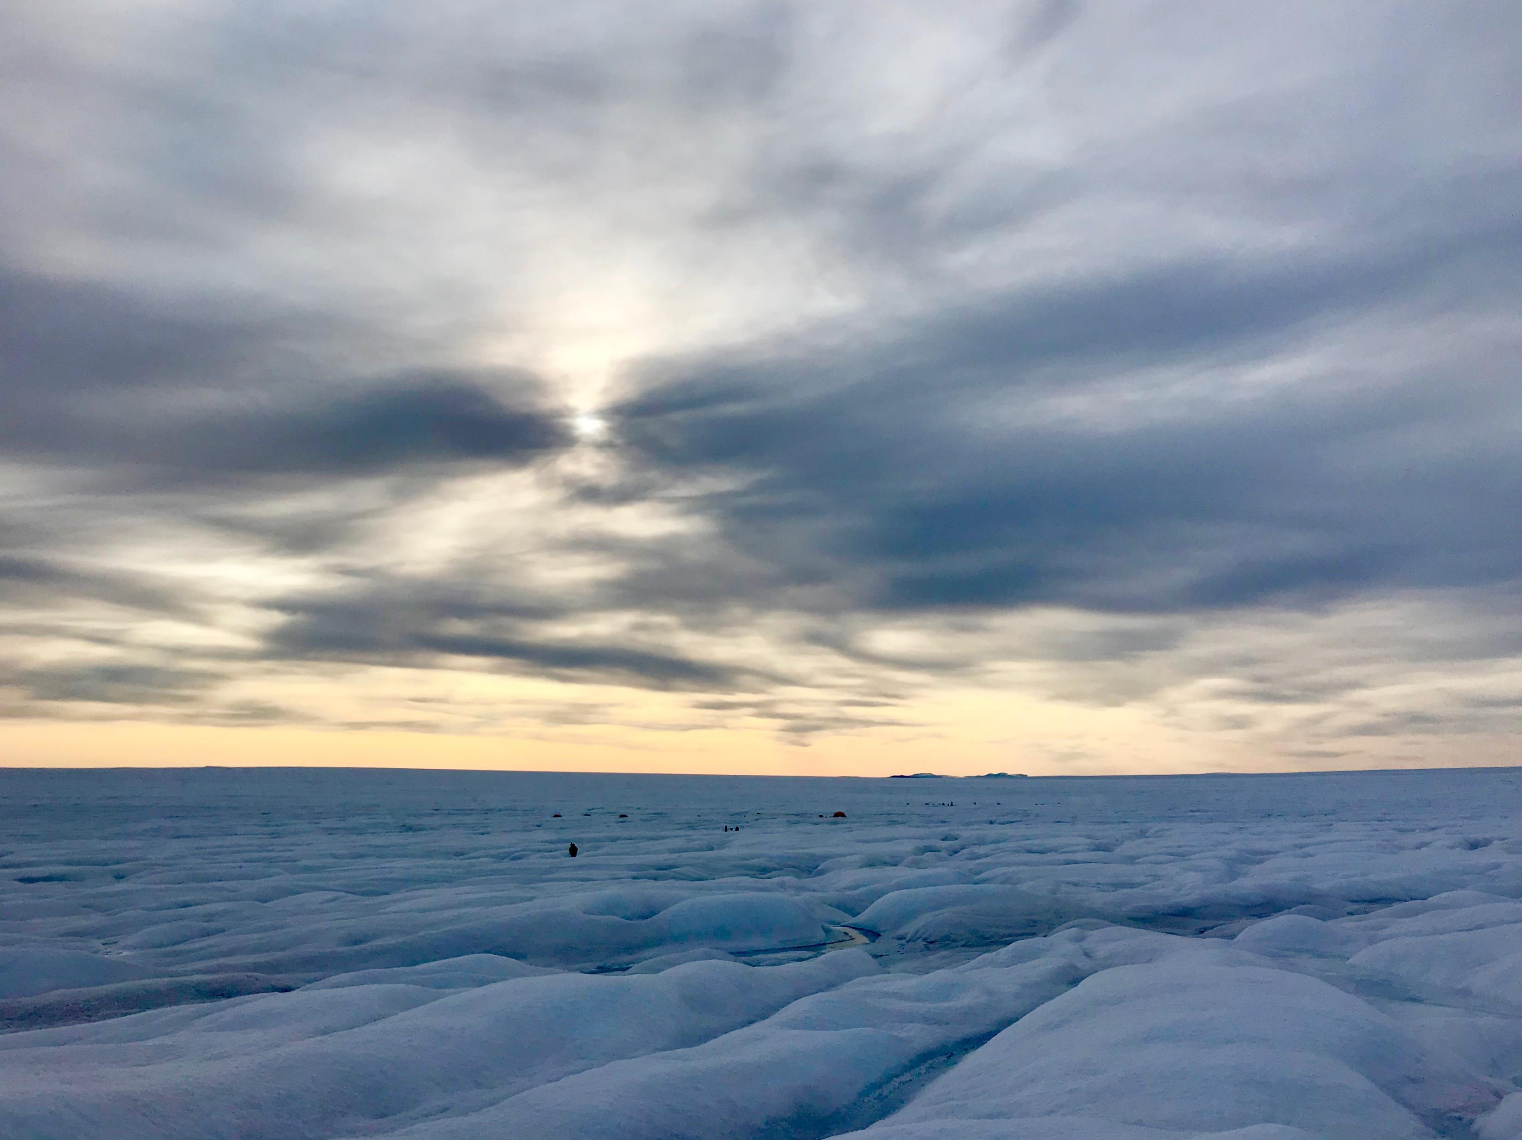
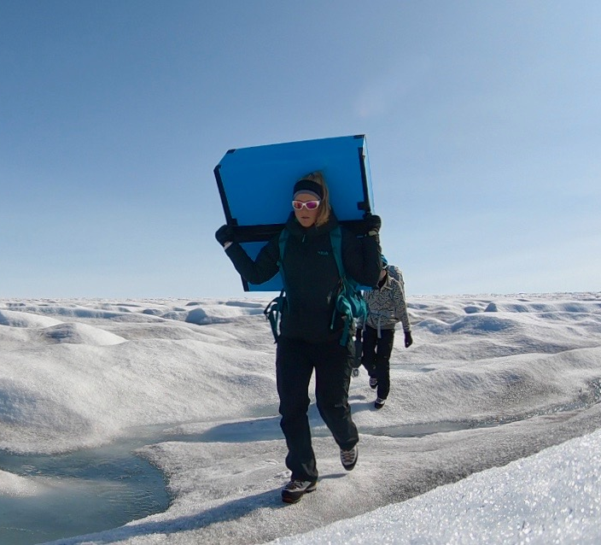
Rough Terrain =Carry Antennas =Buff Scientists
Photo Credits: Eliza

Slide 3
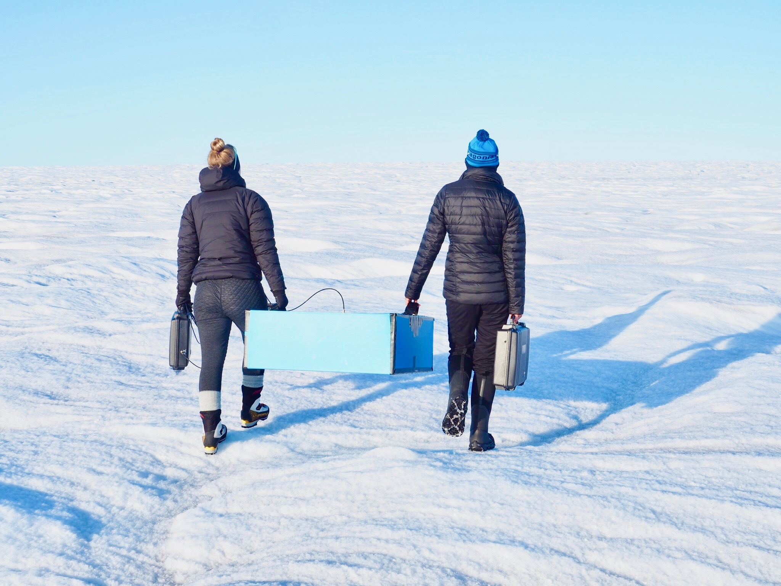
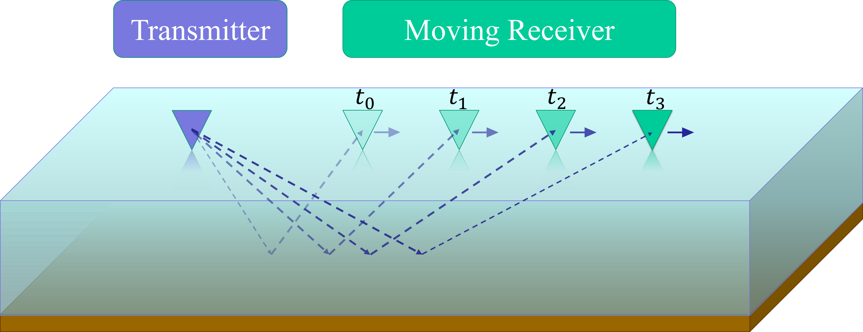
Experimental Configuration
Photo Credits: Eliza

Slide 4
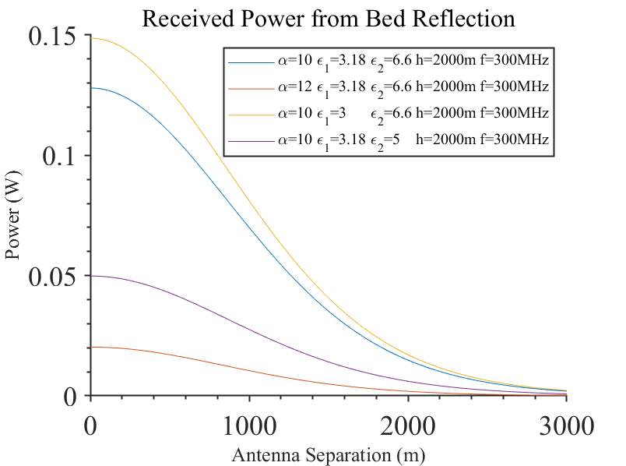
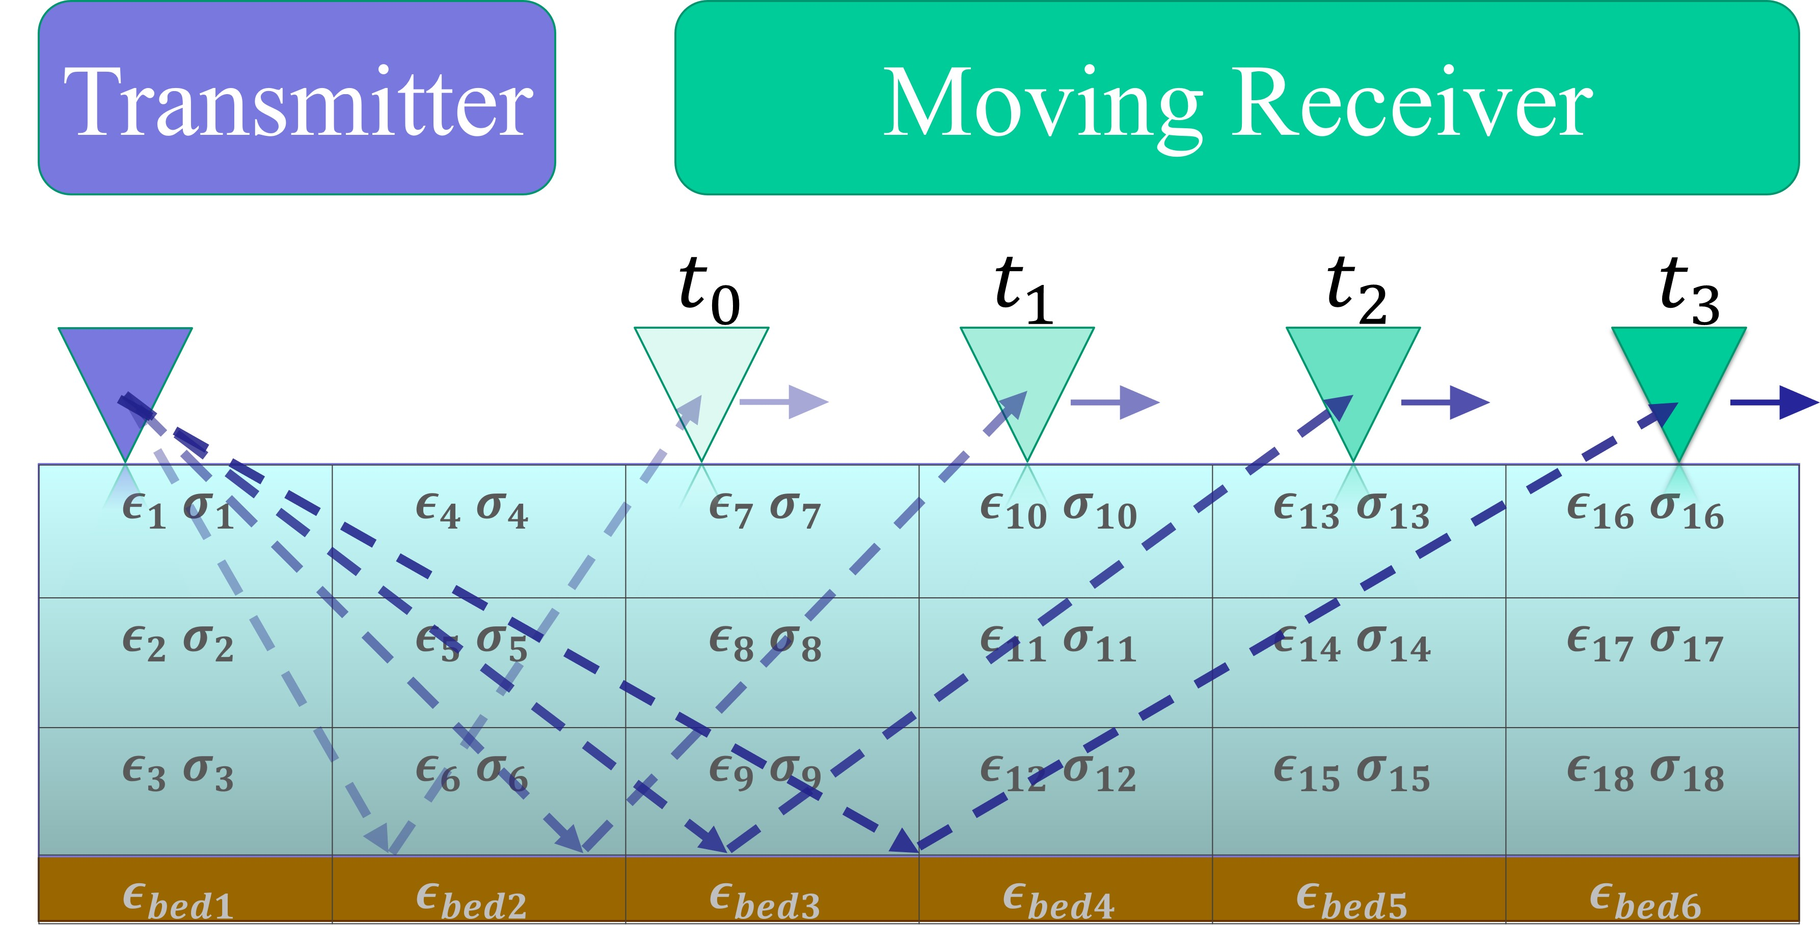
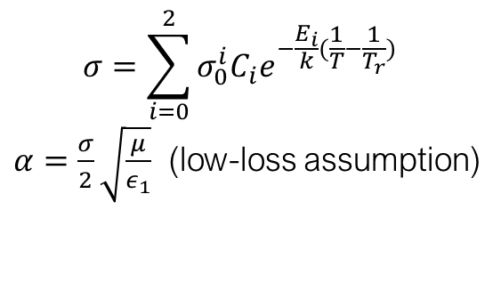
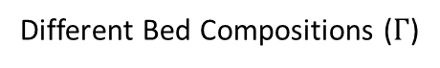
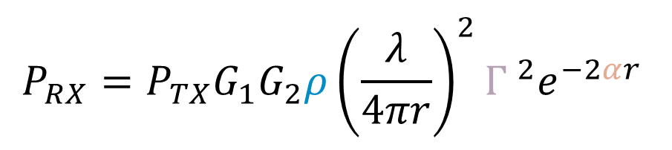
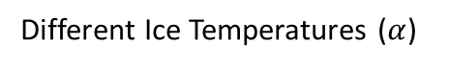
Review of bistatic experiment
Different Ice Temperatures ($α$)
Different Bed Compositions ($Γ$)
$$P_{RX}=P_{TX}G_{1}G_{2}ρ{\left(\frac{λ}{4πr}\right)}^{2}{Γ }^{2}e^{−2αr }$$
Ice temperature
$$σ=\sum_{i=0}^{2}{σ_{0}^{i}C_{i}e^{−\frac{E_{i}}{k}(\frac{1}{T}−\frac{1}{T_{r}})}}$$
$α=\frac{σ}{2}\sqrt{\frac{μ}{ε_{1}}}$ (low-loss assumption)
bed composition
Subglacial stream structure
Bed roughness

Slide 5
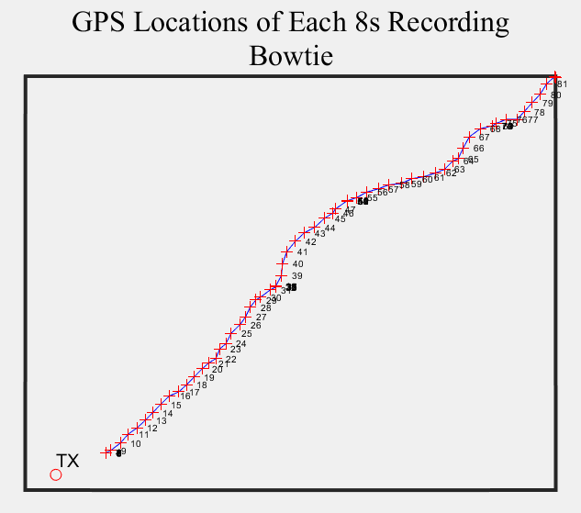
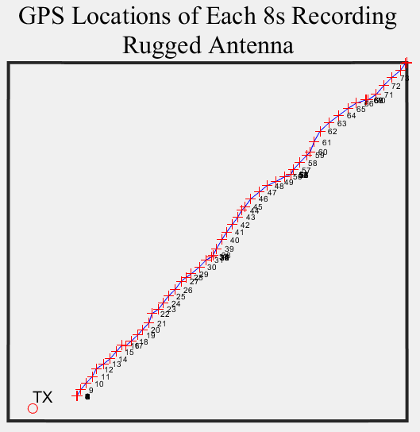
Bistatic Experiments: 0.2 – 2.3km

Slide 6
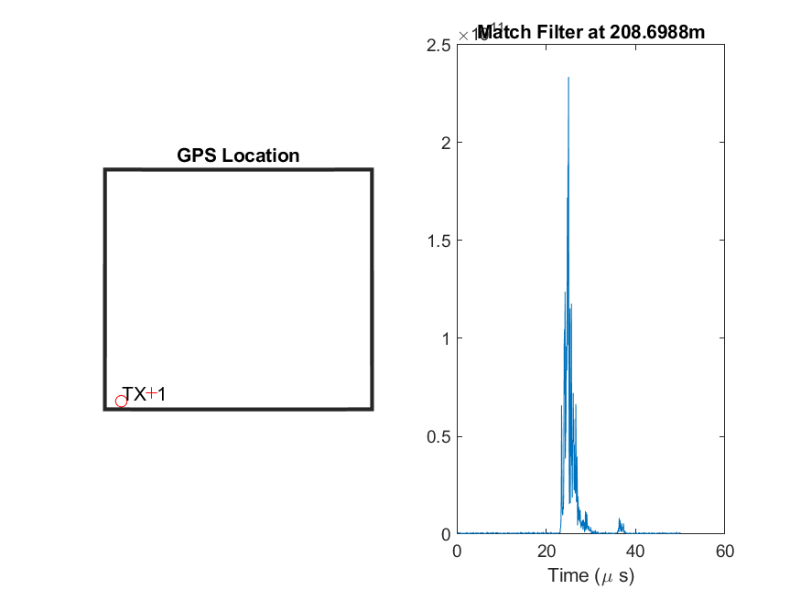
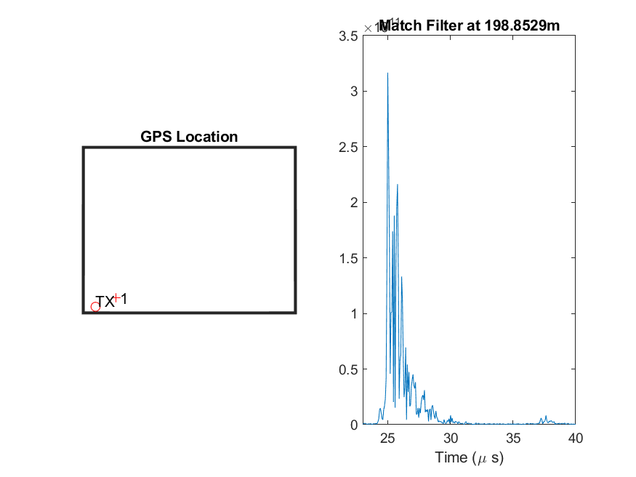
Bistatic Experiments: 0.2 – 2.3km

Slide 7
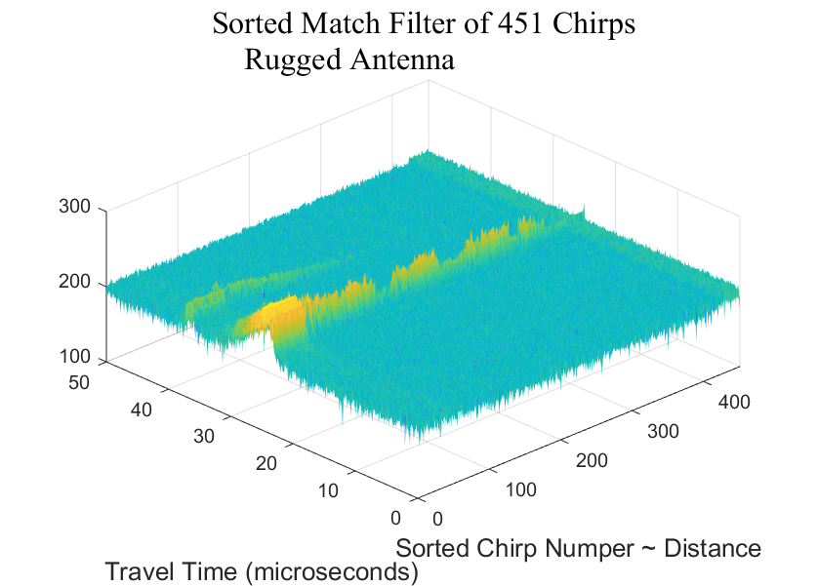
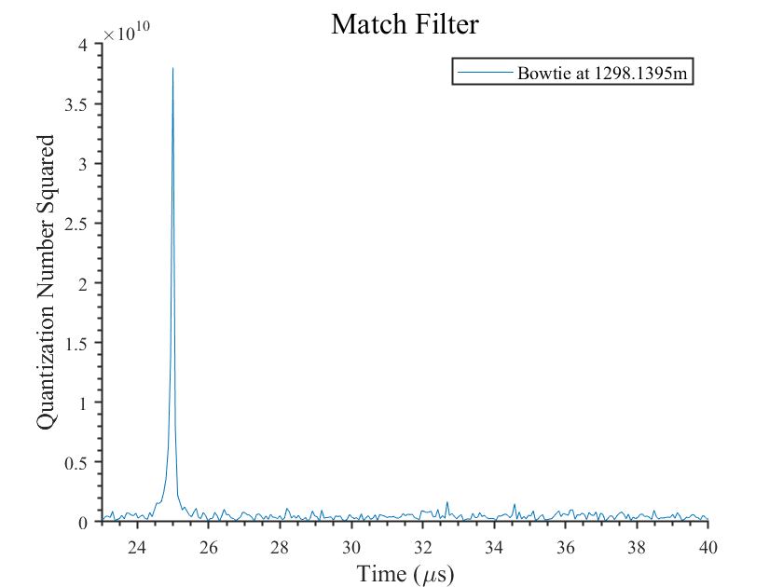
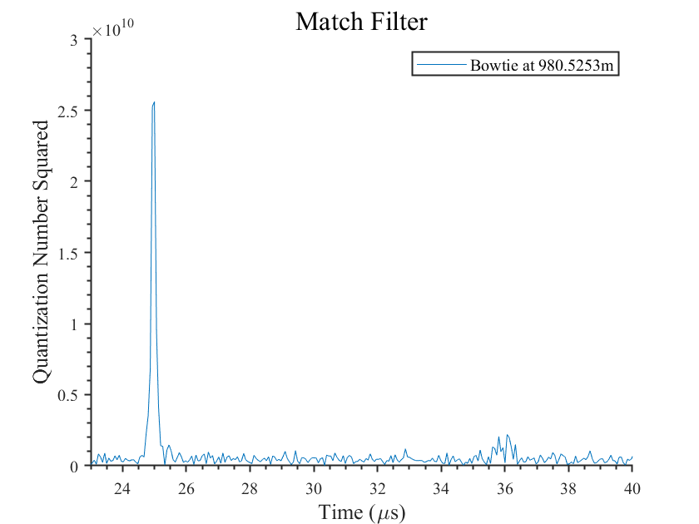
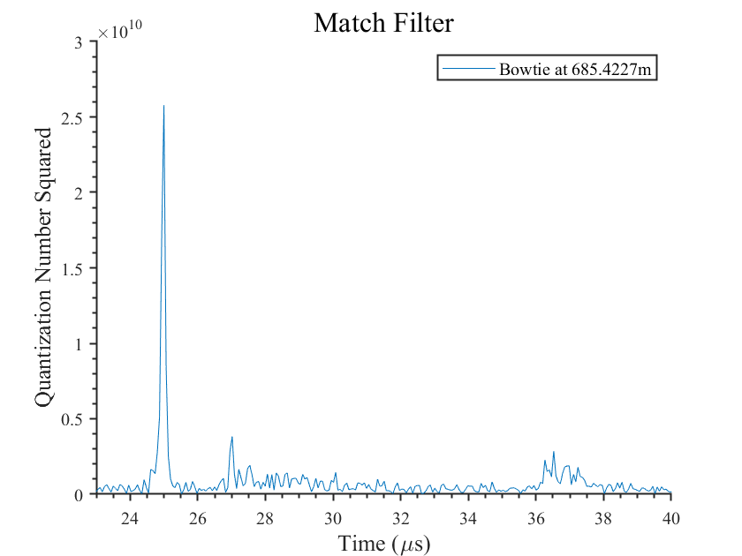
Visualization
Distance / Chirp Number
Time
Chirp Number

Slide 8
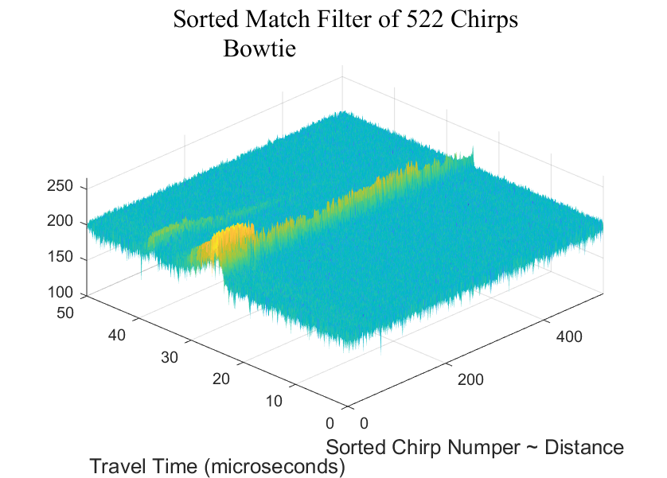
Bistatic Experiments: 0.2 – 2.3km

Slide 9
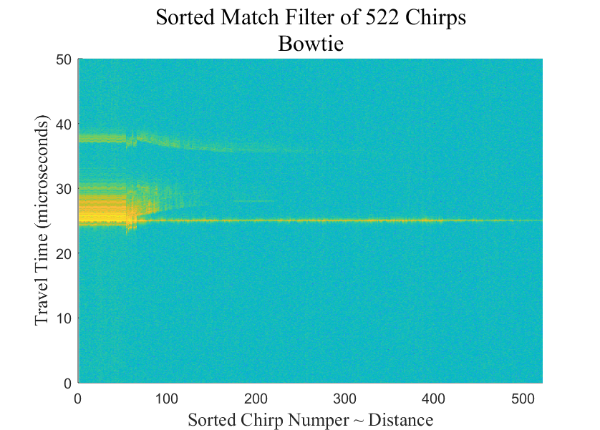
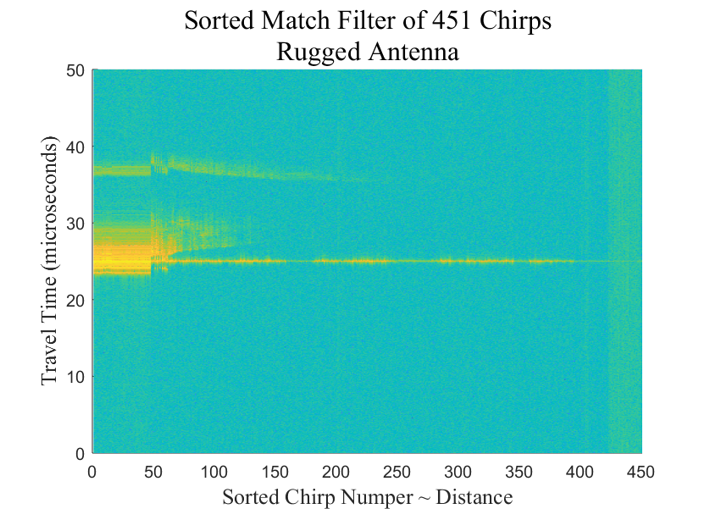
Bistatic Experiments: 0.2 – 2.3km

Slide 10
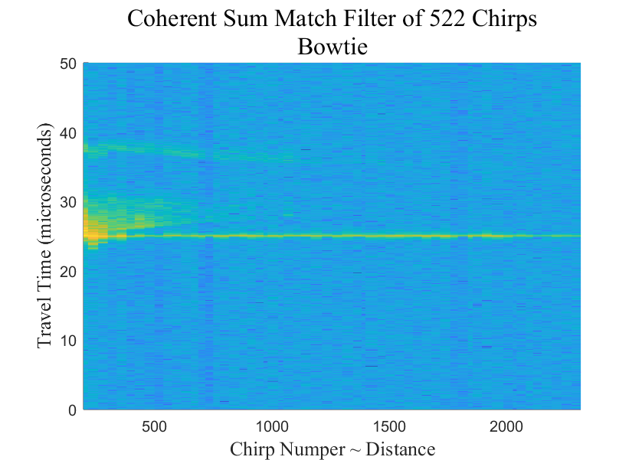
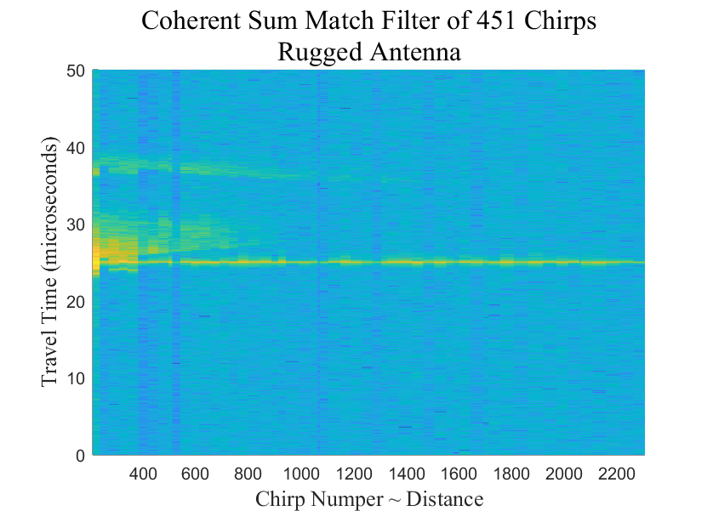
Bistatic Experiments: 0.2 – 2.3km

Slide 11
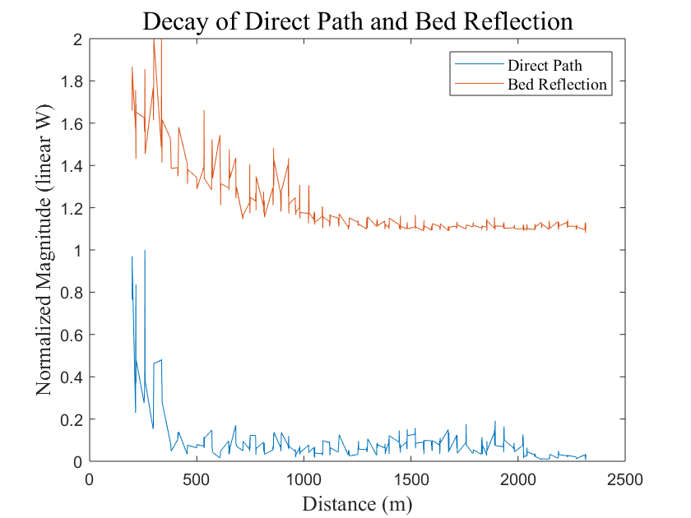
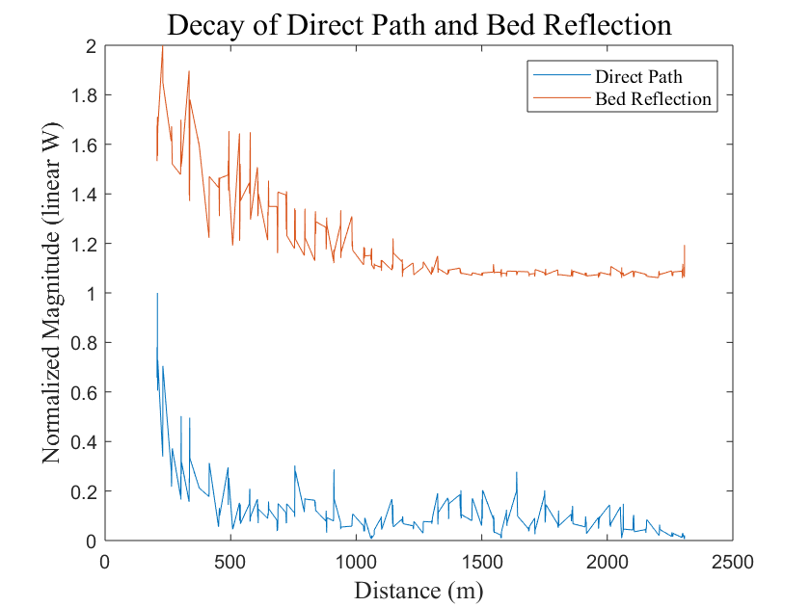
Bistatic Experiments: 0.2 – 2.3km

Slide 12
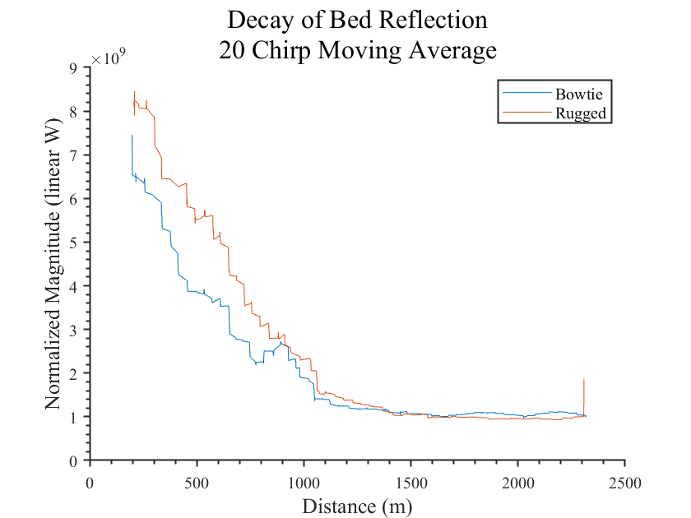
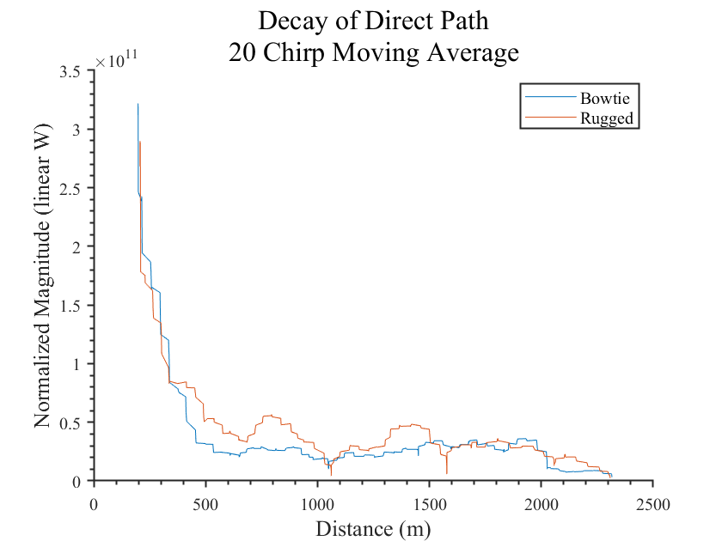
Antenna Comparison
Signal from rugged is usually stronger
Average chirps detected per 8s measurement
Rugged Antenna: 5.2
Bowtie Antenna: 5.6 (31 chirps more over 86 measurements)
1150m
HPBW Rugged Antenna

